Slide 1
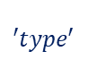
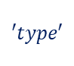

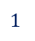
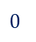
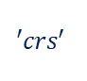

GeoJSON (dict)
$$′type′$$
$$′crs′$$
…
‘features’ (list)
$$0$$
$$1$$
…
gi (dict)
…
$$N$$
$$′type′$$
‘geometry’ (dict)
‘properties’ (dict)
Dictionary with geographic identifiers. The dictionary might include more than one identifer (key). For instance, the data might include both ‘municipality’ and ‘region’ data:
‘type’ (str)
‘coordinates’ (list)
Specifies the geographic shape that ‘coordinates’ refers to. Should be either ‘Polygon’ or ‘MultiPolygon’.
Specifies the coordinates that are plotted in the map. The notation is slightly different depending on whether ‘type = Polygon’ or ‘MultiPolygon’..
$$\{^{′}KOMNAVN^{′}:\text{'}\text{K}\text{ø}\text{benhav}n′, \\ ′region^{′}:′Hovedstaden′\}$$

Slide 2

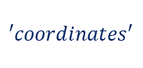
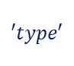
GeoJSON (dict)
$$′type′$$
$$′crs′$$
…
‘features’ (list)
$$0$$
$$1$$
…
gi (dict)
…
$$N−1$$
$$N$$
$$′type′$$
‘geometry’ (dict)
‘properties’ (dict)
Dictionary with geographic identifiers. The dictionary might include more than one identifer (key). For instance, the data might include both ‘municipality’ and ‘region’ data:
$$′type′$$
$$′coordinates′$$
$$\{^{′}KOMNAVN^{′}:\text{'}\text{K}\text{ø}\text{benhav}n′, \\ ′region^{′}:′Hovedstaden′\}$$

